Slide 1
Supplier Proposal Adequacy Guidelines
Greg Manley
September 5, 2023
Use of U.S. DoD visual information does not imply or constitute DoD endorsement.

Slide 2
External Customer Feedback
The DCAA has begun strictly enforcing FAR Part 15.408 requirements for contractor and sub-contractors for the submission of cost or pricing data to support single source proposals exceeding the $TINA threshold.
A significant number of AR Supplier proposals have been determined by the DCAA to be inadequate for a number of reasons including the lack of:
  An Index
  An Adequate FAR 15.2 Table
  A Consolidated Bill of Material
  A time phased cost breakdown by period of performance
  Lack of Basis of Estimates (Labor and Material)
  Supporting rationale for development of direct and indirect cost elements by year for the entire period of performance

Slide 3
Purpose of This Guideline
The purpose of this package is to provide guidance to suppliers for submitting FAR compliant cost proposals. The charts provided are basic examples that depict the type of cost disclosures required to support a FAR 15 compliant proposal.
Each AR supplier, however, has an independent obligation to ensure that its proposals submitted in support of a USG prime contract fully comply with all regulatory requirements.
AR is not recommending your use of these charts for proposal purposes. However, we are providing them for your use as a reference guide only in the preparation and submittal of your cost proposal that must be FAR compliant.
This guideline does not apply to proposals that are:
  Valued at less than the cost or pricing threshold set in FAR 15.403-4.
  Based on competition.
  Based on commercial pricing.
Site Location – Canoga Park
Address – 8900 De Soto Avenue Canoga Park, CA 91304
1345 employees and 170 temps – 1515 people total

Slide 4
Vital Items for FAR 15 Proposal
FAR 15.403-4 sets forth those circumstances in which contractors are required to submit certified cost or pricing data. The responsibility for providing well-prepared and fully supportable cost proposals for sole source acquisitions that exceed the TINA threshold lies solely with the contractor. The basis and rationale for all proposed costs shall be provided as part of the proposal so that the contracting officer (CO) may rely on the information as sufficiently current to permit negotiation of a fair and reasonable price.
FAR 15.403-4(a)(1)(iii) states subcontractors at all tiers are also required to provide certified cost and pricing data if the subcontractor proposal is above the TINA threshold and no exceptions apply. If the subcontract exceeds the TINA threshold, the prime contractor is required to conduct and provide a price/cost analysis establishing the reasonableness of each subcontract price.

Slide 5
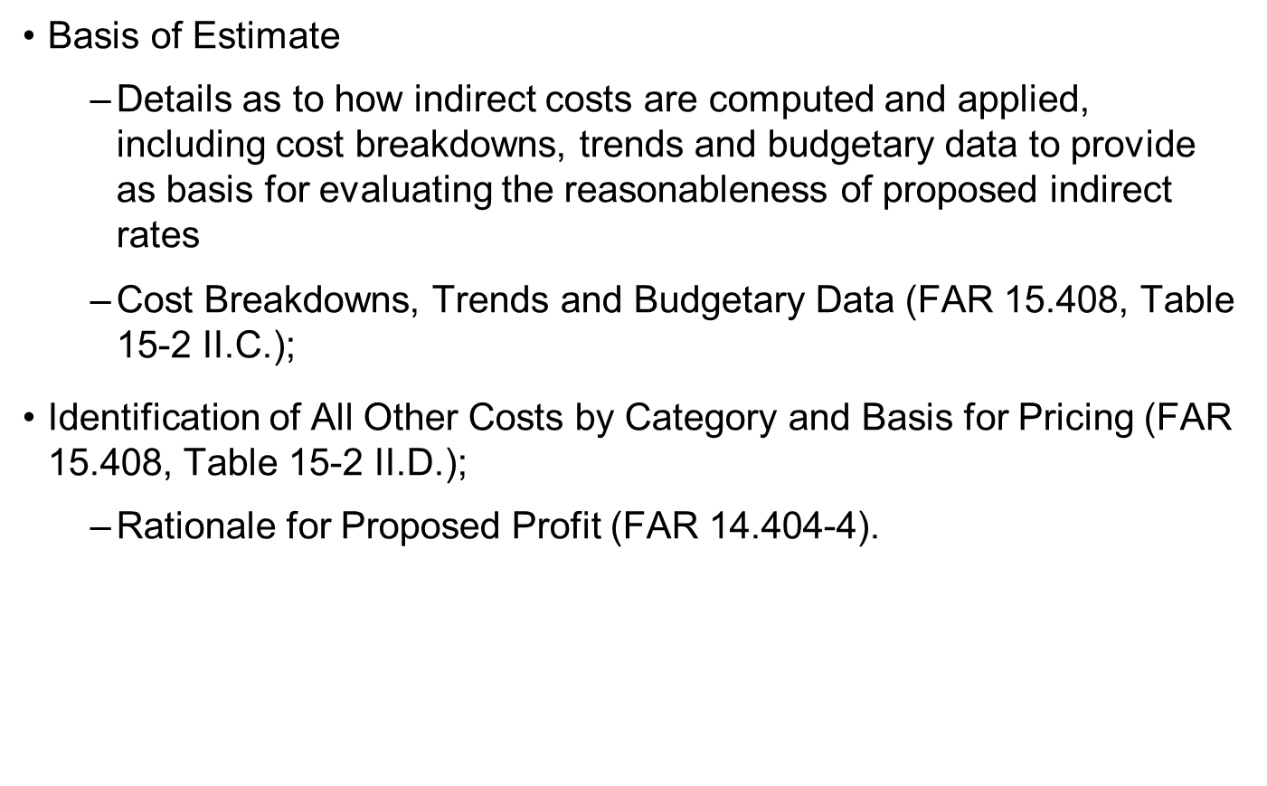
Vital Items for FAR 15 Proposal

Slide 6
Vital Items for FAR 15 Proposal
Summary of Total Cost by Element
  Cross-referenced to each line item
Breakdown of Labor (FAR 15.408, Table 15-2 II.B.)
  Hours
  Rates and Costs by Appropriate Category
  Basis for estimates
Consolidated Priced Bill of Materials
  Types, Quantities, Cost, basis for pricing
  FAR 15.408, Table 15-2 II.A.
  Cost element breakdown in proper format for each line item

Slide 7
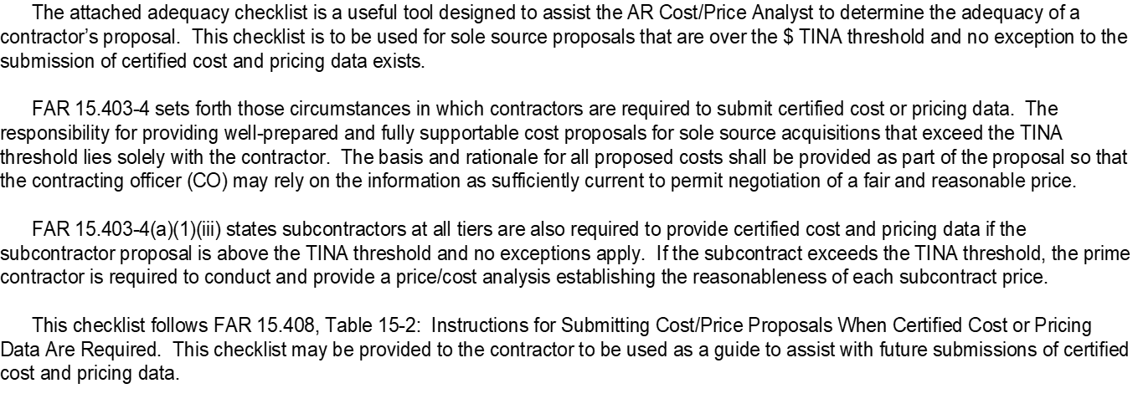
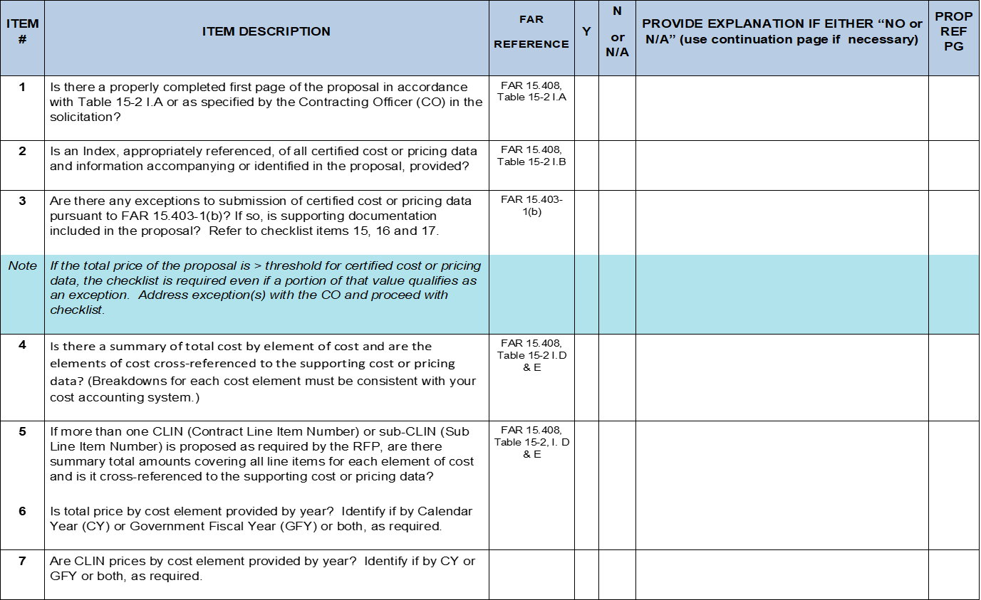
DCMA Proposal Adequacy Checklist
An “Adequacy Checklist for Price Proposals” developed by the DCAA/DCMA is a requirement with all requests for cost or pricing data that support requirements outlined in FAR 15.408 Table 15-2.
Your completed proposal must meet the requirements outlined in the Proposal Adequacy checklist.
DCAA assist audits will not be requested without confirmation that you have addressed these requirements.

Slide 8
Proposal Index
Include an index that references where the supporting data for your estimates is located in the proposal.
  The index should include the following:
    Title of information being referenced (Summary cost element breakdown, material, labor, etc.).
    Location in the proposal (page number or file name and page if located in a separate file).
Site Location – Canoga Park
Address – 8900 De Soto Avenue Canoga Park, CA 91304
1345 employees and 170 temps – 1515 people total

Slide 9
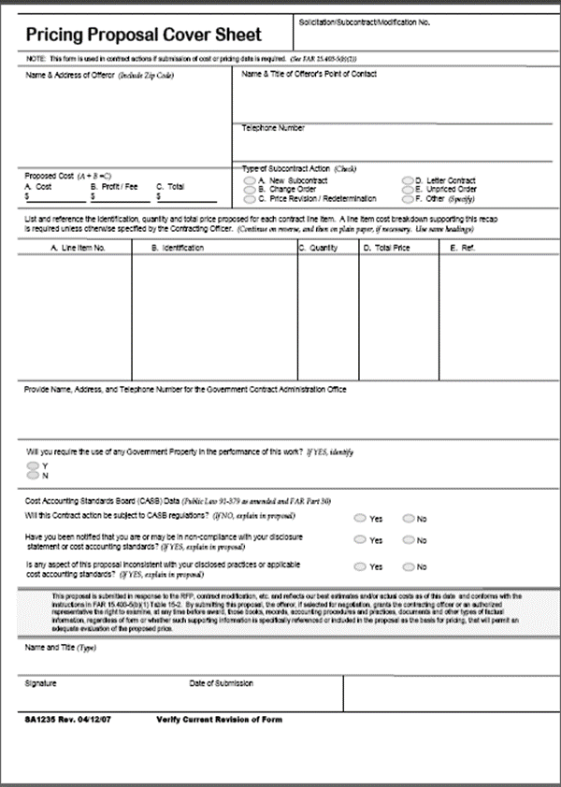
Cover Sheet
Include a cover sheet that includes the following information:
  Solicitation number.
  Name and address of offeror.
  Name and telephone number of point of contact.
  Name, address, phone number and email for your DCMA and DCAA.
  Type of contract action.
  Proposed cost, profit or fee, and total price –maximum proposal value.
  If you will require the use of government property.
  Whether your organization is subject to cost accounting standards (CAS) –see details in FAR 15.408, Table 15-2, I.A. (8).
  The statement designated in FAR 15.408, Table 15-2, I.A. (9).
  Date of submission.
  Name, title and signature of authorized representative.
Most contractors use the Government Form 1411.
Site Location – Canoga Park
Address – 8900 De Soto Avenue Canoga Park, CA 91304
1345 employees and 170 temps – 1515 people total

Slide 10
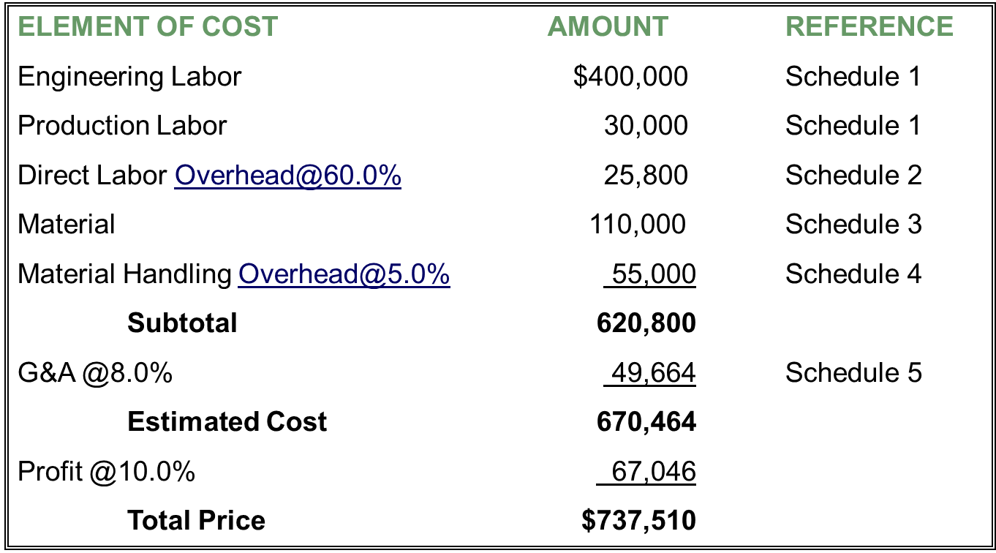
FAR 15.2 Table Example

Slide 11
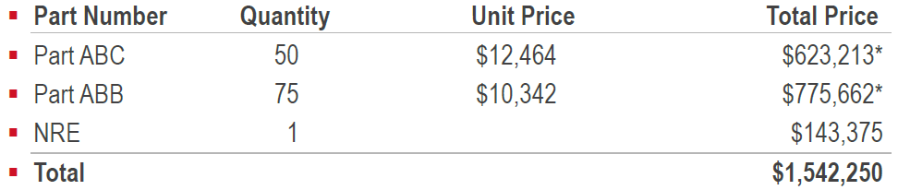
Cost Element Breakdown by Line Item
  A cost element breakdown is required for each proposed line item. If the proposal covers multiple price points or multiple years, a cost element breakdown will be required for each price point for each year.
    For example, assume your proposal includes the following three line items:
  You would need to provide separate cost element breakdowns for Parts ABC, ABB and the NRE. See the next slide for an example.
    * Slight differences due to rounding.
Site Location – Canoga Park
Address – 8900 De Soto Avenue Canoga Park, CA 91304
1345 employees and 170 temps – 1515 people total

Slide 12
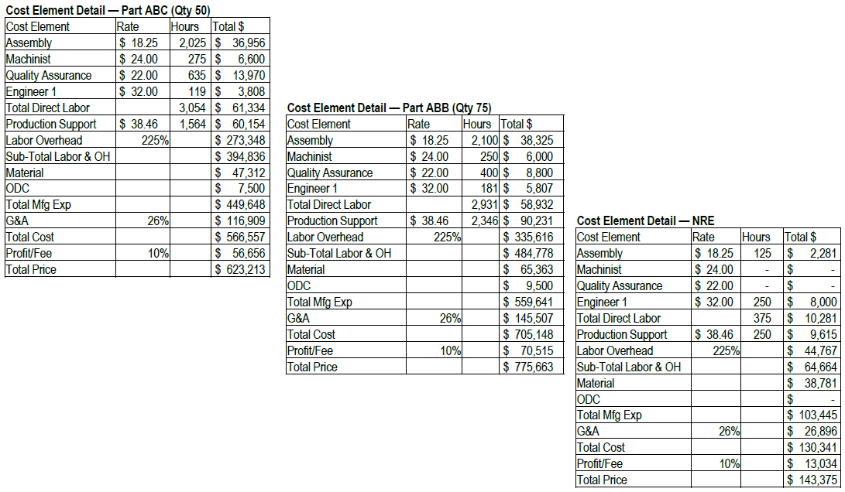
Cost Element Breakdown by Line Item Example
Site Location – Canoga Park
Address – 8900 De Soto Avenue Canoga Park, CA 91304
1345 employees and 170 temps – 1515 people total

Slide 13
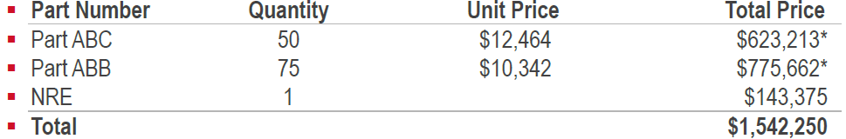
Summary Cost Element Breakdown
When more than one contract line item (Part number, NRE etc.) is proposed, you must provide summary total amounts covering all items for each element of cost. If the proposal covers a high, mid and low point, the summary needs to only be for those points, not all the different combinations that can result from range pricing. If the proposal is for multiple years there needs to be a summary for each of the years.
  For example if your proposal included the following :
  You would need to provide a summary by cost element that includes the total proposed value of $1,542,250. See the next slide for an example showing the three individual cost elements being combined into a summary.
  * Slight differences due to rounding.

Slide 14
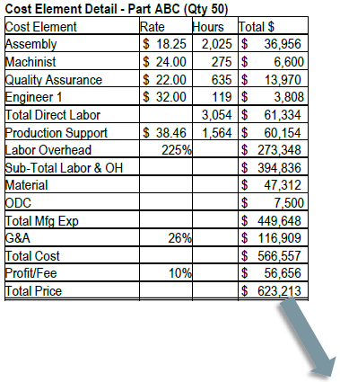
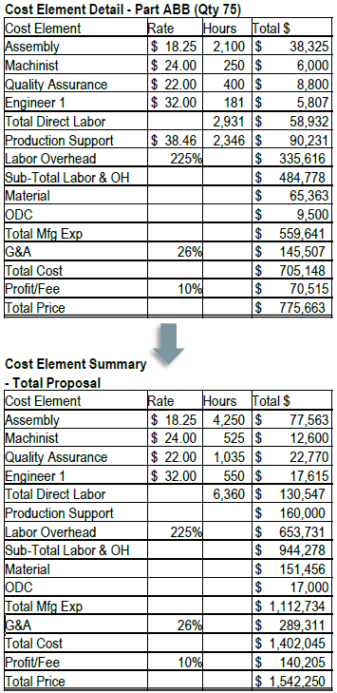
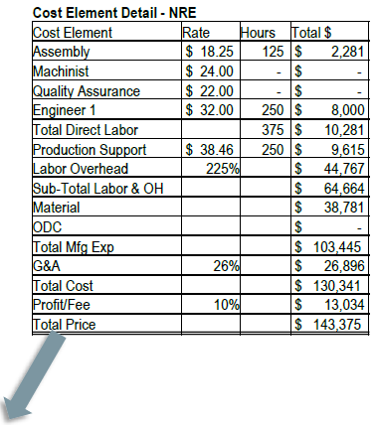
Summary Cost Element Breakdown Example

Slide 15
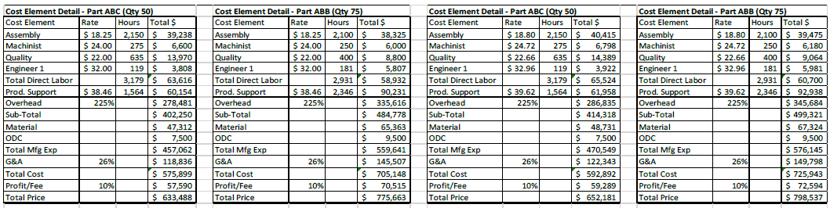
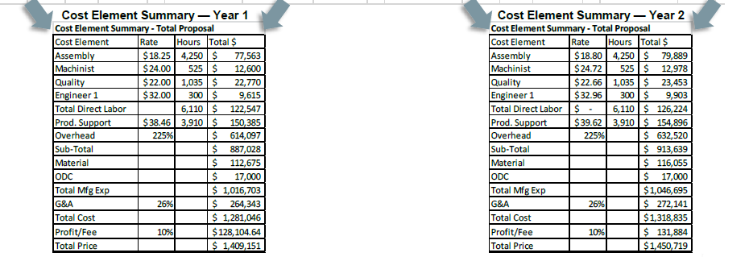
Summary Cost Element Breakdown
If the proposal is for a base year plus option years, there needs to be a summary Cost Element Breakdown for each of the years at the points in the RFP requiring Cost or Pricing.

Slide 16
Material
Include a BOM for each individual part proposed. A BOM is a list of the raw materials, subassemblies, etc., needed to manufacture a product. Provide your BOMs in Excel format.
  The consolidated and individual BOMs need to identify the following for each line item:
  Part number and description.
  Supplier.
  Quantity.
  Unit price –Unit pricing on the BOM should tie to the support.
  Total price.
  Basis for Pricing/Basis of Estimate (vendor quotes, purchase orders).**
  **Source of pricing (PO, quote, etc.) must be referenced in the BOM.

Slide 17
Material
If attrition/yield or scrap are added to your material, you will need to submit adequate basis of estimates and support as appropriate.
There are times when your BOM may be impacted by minimum buys or NRE that is passed along from your supplier. If this happens, make sure this is clearly identified on the BOM and the supporting quotes or Purchase Orders(PO’s).
In addition to the individual BOMs, FAR requires a consolidated BOM in your proposal. A consolidated BOM is a listing of all the material needed for the proposal. A consolidated BOM combines all the materials for each of the parts being proposed, as well as assemblies, services or material associated with NRE.

Slide 18
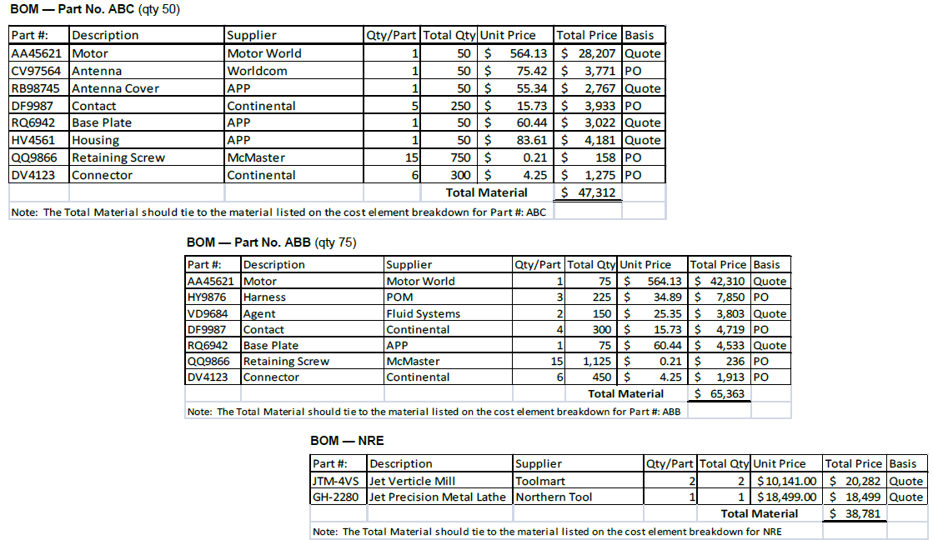
Individual Bills of Material Example

Slide 19
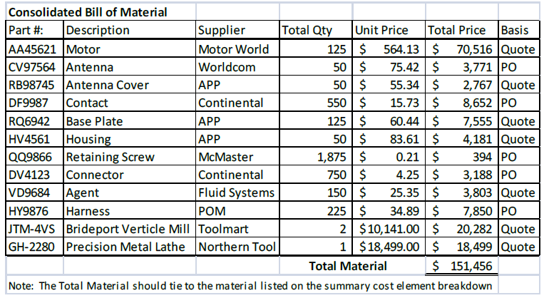
Consolidated Bill of Material Example
Below is an example of a consolidated BOM. This BOM was developed by taking the three individual BOMs on the previous page and combining them together.
  In a consolidated BOM part numbers and quantities should be combined (or subtotaled) if they are the same parts. For example the BOMs for Part Nos. ABC and ABB both require the same motor –Part No. AA45621. In the consolidated BOM the requirements have been combined and reflect the total number of motors that will be needed for this proposal.

Slide 20
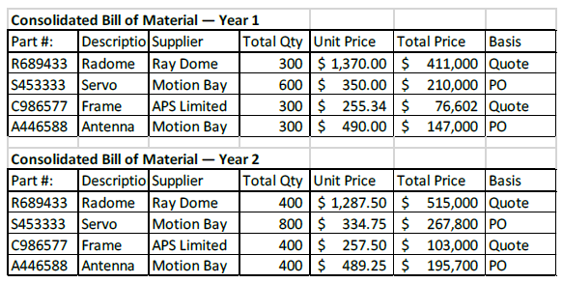
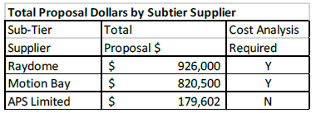
Consolidated Bill of Material
If the proposal is for a base year plus option years, there needs to be a consolidated BOM for each of the years at each of the points in the RFP requiring cost or pricing.
To determine if a sub tier cost analysis is required, you need to add together the anticipated costs for each supplier for all years. In the above example there are two suppliers that will require a cost analysis (Ray Dome and Motion Bay).

Slide 21
Material
Refer to the detailed instructions in the RFP when your proposal supports a base year plus options contract or a long-term agreement. Guidance should be provided here on the consolidation and subtler requirements. If you have any questions regarding this, contact your Supply Chain representative.
Interorganizational costs
  Interorganizational costs are defined as the cost of items transferred between divisions within the same company.
  If you have bid any interorganizational costs in your proposal, you will need to provide a cost element breakdown for each interorganizational transfer and support as appropriate.
Note:
  If you have a supplier with a value in excess of $13.5 million or is greater than 10 percent of your total proposal and exceeds $TINA, FAR 15.408 Table 15-2 requires that we submit the supplier’s proposal and cost or pricing data with our own proposal.

Slide 22
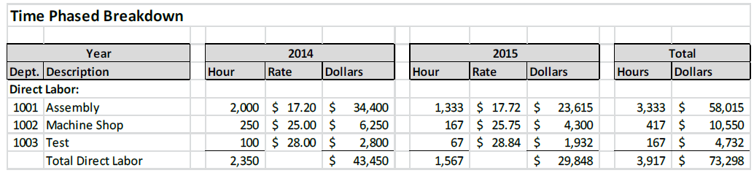
Labor
Labor hours:
  Provide a time-phased (e.g., monthly, quarterly) breakdown of labor hours, rates and cost by appropriate category, and furnish basis for estimates.
  Please show the analogy and or nexus of prior actuals/historical data to the proposal estimate (Basis of Estimate/Estimate Methodology).

Slide 23
Labor
Labor hours:
  Proposed labor hours are generally a combination of direct and support labor hours.
    Direct labor hours –Hours that can be identified specifically to a final end item.
    Support labor hours –Hours that cannot be specifically identified to one end item. For example, a production manager may be in charge of overseeing the manufacturing of multiple parts.

Slide 24
Labor
Please provide a breakdown of the labor hours by labor category and function along with a basis of estimate for the proposed labor hours.
  For example if you propose 500 hours for an end item, you would need to provide a breakdown by category/function (assembly, inspection, supervisor, engineer, etc.). You also need to provide a detailed basis of estimate for each category/function showing how you arrived at the hours for the proposed labor category.
  Generally the basis should be actual production history. An alternative approach is the use of engineering estimates if the item has not been manufactured before.
Cost Accounting Standards (CAS) 401 requires that a company is consistent between proposals and accounting practices. The way a company estimates its labor hours needs to also be the way it accumulates its production history.

Slide 25
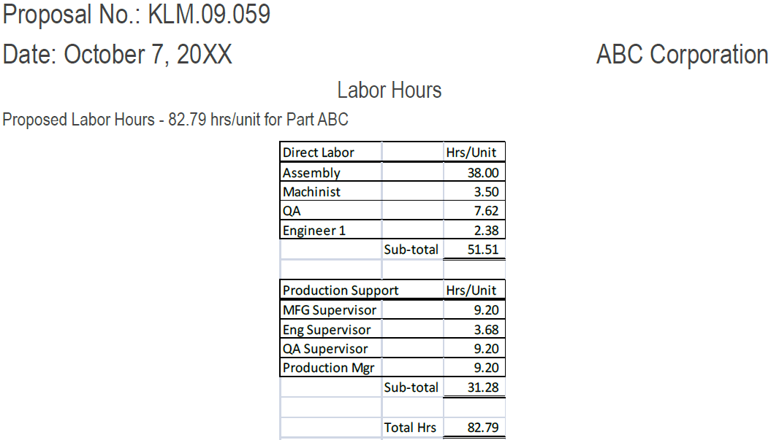
Labor Hours Example

Slide 26
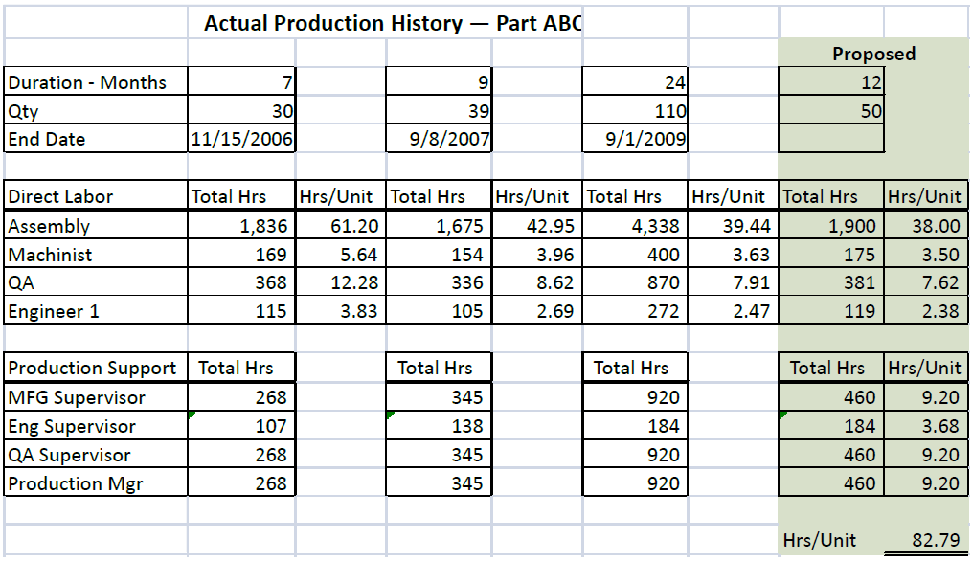
Labor Hours
Example – Actual Production History

Slide 27
Labor Hours Examples – Basis of Estimate
Basis of estimate for direct labor:
  Proposed direct labor hours were developed by applying a 90 percent learning curve to the production labor history for part BBC. You need to provide basis for the 90 percent curve.
Basis of estimate for the manufacturing supervisor:
  The manufacturing supervisor’s time is based on the latest production history for Part ABC. The latest production history for Part ABC (shown on the previous page) shows that 920 hours were used over a 24-month period. Since the current proposal has been estimated to cover 12 months, 460 hours were applied for the manufacturing supervisor (920 divided by 2).
Basis of estimate for engineering supervisor:
  The engineering supervisor’s time is based on the latest production history for Part ABC. The latest production history for Part ABC (shown on the previous page) shows that 184 hours were necessary to complete the task. This task is similar, and so we estimate 184 hours.

Slide 28
Other Direct Costs (ODC)
Other direct costs (ODC)
  List other expenses not otherwise included under material and labor (e.g., travel, freight) and provide basis for pricing.
  For example, the basis for travel would include the location, number of trips, number of people attending and the estimated expenses for the travel.

Slide 29
Nonrecurring Expenses (NRE)
Nonrecurring Expenses (NRE)
    NRE refers to one-time costs that you would not normally see from proposal to proposal.
      Examples of NRE are as follows:
        Special tooling.
        New equipment.
        Equipment refurbishment.
        Hours and materials associated with increasing throughput capacity.
        Hours and materials to research, develop, design and test new processes.
        One-time review events.

Slide 30
Rates
As mentioned earlier, NRE charges must be broken out by cost element. This means the material and labor components associated with the NRE are clearly broken out.
  Material –any material associated with NRE should be supported by supplier quotes or Purchase Orders.
  Labor –labor hours associated with NRE should have basis of estimates (BOE) that are broken down by labor category and include detailed descriptions of the tasks that will be performed.

Slide 31
Rates
Overhead
Generally, costs incurred that are not chargeable directly to the finished product
Overhead Formula
Overhead expenses minus Unallowables
-----------------------------------------------------
Direct Labor $
G&A
G&A many times includes management (i.e. indirect) Fees, Franchise Tax, Sales Tax, Bank Charges, Legal etc.
G&A Formula
G&A Expenses – Unallowables
----------------------------------------------
Total Overhead Expenses + Total Material $ + Total Direct Labor $
Facilities capital COM:
When you elect to claim COM, submit a completed form CASB-CFM (Facilities Capital Cost of Money Factors Computation) in accordance with FAR 31.205-10. Also, complete DD Form 1861 and include a copy in your proposal submission. Both forms can be found online at various locations.

Slide 32
Rates
Rates include direct labor, overhead, general and administrative expense (G&A) and cost of money (COM).
AR has the capability to perform rate audits on suppliers in lieu of having the DCAA do this.
If you allow AR to perform this rate audit, you need to provide the following information:
  Explanation as to how the rates were calculated.
  Detailed documentation (financial statements, labor pools, listing of unallowable expenses, etc.) that support the rate calculations.
  If the detailed documentation is based upon budgetary numbers, you will also need to provide three years of your most current actuals to support your budgetary numbers.
  If budgetary numbers differ significantly from the most recent actuals, provide detailed explanations for these differences.

Slide 33
Audit Rights
Audit rights are a set of purchase contract clauses, or an established business practice, that define AR’s right to examine supplier direct and indirect incurred cost data, projections, and accounting policies and procedures.
AR audit rights are required to be included in any purchase contract issued by the AR Company to a supplier. Purchase contracts excluding certain criteria, shall include contractual provisions allowing audit examination by qualified AR personnel or a waiver to audit rights must be obtained.
There are four categories of audit rights clauses:
Full Access (No Audit Rights Waiver) - The supplier allows unrestricted access to all of the necessary records to verify that all direct and indirect costs and/or projections, including rates and factors, are allowable, allocable and reasonable to the effort being audited.
Partial Access (Partial Audit Rights Waiver) - In this situation the supplier normally allows AR unrestricted access to records related to direct hours and material costs only. For government prime contracts, the Government or an independent audit agency performs audit support for rates and factors and provides audit results to AR. With this type of waiver, the analyst must request audit assistance from the Government for the review/audit of the rates and factors.
No Access (Full Audit Rights Waiver) - AR has been denied access to the supplier’s records supporting all direct and indirect costs. For government prime contracts, the Government or an independent audit agency performs the audit on direct and indirect costs and provides audit results to AR. In this situation, the analyst will request the Government to conduct a full audit of all direct and indirect costs. This is the least desirable type of "audit" rights.
•Blanket Waiver of Audit Rights - Under certain circumstances, AR may have a blanket waiver to defer audit rights of rates and factors to the Defense Contract Audit Agency (DCAA).
AR would prefer to have full audit rights and not have to rely on the Government to conduct an assist audit.
Standard terms and conditions of the purchase contract usually request full audit rights from the suppliers. However, most suppliers only allow AR partial access.

Slide 34
FAR References
FAR 15.404-2 "Information to Support Proposal Analysis"
http://www.acqnet.gov/far/
FAR PART 15 – Contracting By Negotiation
FAR PART 31 – Contract Cost Principles
OMB Circular A-122 – Cost Principles for Non-Profit Organizations
Contract Pricing Guides
DCAA – www.dcaa.mil
FAR 15.404-3 Subcontract pricing considerations.
The contracting officer/buyer is responsible for the determination of price reasonableness for the prime contract, including subcontracting costs. The contracting officer should consider whether a contractor or subcontractor has an approved purchasing system, has performed cost or price analysis of proposed subcontractor prices, or has negotiated the subcontract prices before negotiation of the prime contract, in determining the reasonableness of the prime contract price. This does not relieve the contracting officer from the responsibility to analyze the contractor’s submission, including subcontractor’s cost or pricing data.

Slide 35
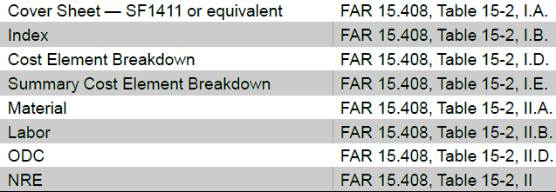
Summary
In summary, all noncompetitive, noncommercial proposals valued at more than $TINA are required to include the following information:
Sufficient rationale and supporting documentation to support each of the proposed cost elements is also required.
Obtaining adequate supplier proposals is always on the critical path, since AR cannot submit its proposal to the government until it has received adequate proposals from its subcontractors. Therefore, it is critical that adequate supplier proposals are obtained as quickly as possible.

